Slide 1
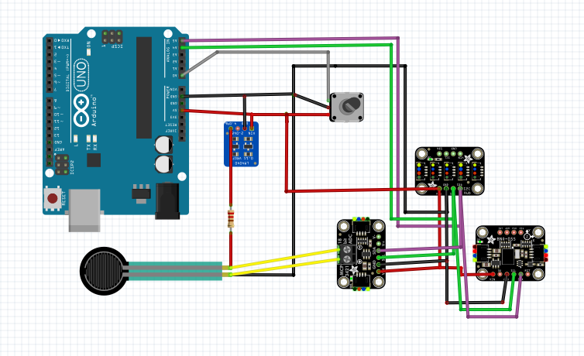
SDA
SCL
Parallel Circuit
GND
5V
Rot Enc
Adafruit Qwiic / Stemma QT 5 Port Hub
Precision LM4040
Voltage Reference
4.096 V
100 ohm
Adafruit BNO055 IMU
LMST
(in series with 100 ohm resistor)
Adafruit_MCP3421 18 bit ADC
(in parallel with LMST)

Slide 2
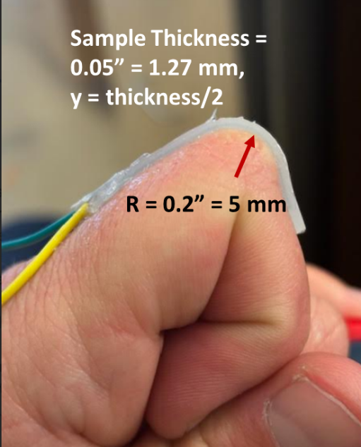

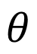
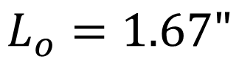
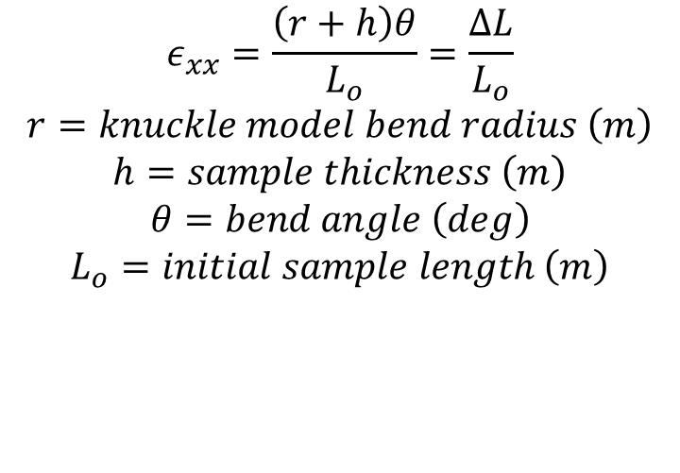
Human Knuckle Model
$$L_{o}=1.67"$$
h = 0.05” (1.27 mm)
r = 0.125”
$$θ$$
Measured Strain on finger with sample abs_100
(using strings)
~ 0.1677 or 16.8%
$$ε_{xx}=\frac{\left(r+h\right)θ}{L_{o}}=\frac{ΔL}{L_{o}}$$
$$r=knuckle model bend radius \left(m\right)$$
$$h=sample thickness \left(m\right)$$
$$θ=bend angle \left(deg\right)$$
$$L_{o}=initial sample length \left(m\right)$$

Slide 3

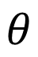
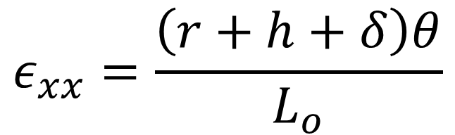
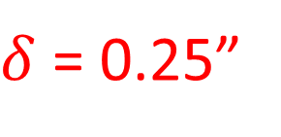
Auto Bender Model
h
r
$δ$ = 0.25”
$$θ$$
Measured Strain on sample abs_100 on AutoBender
~ 0.4 or 40%
$$ε_{xx}=\frac{\left(r+h+δ\right)θ}{L_{o}}$$

Slide 4
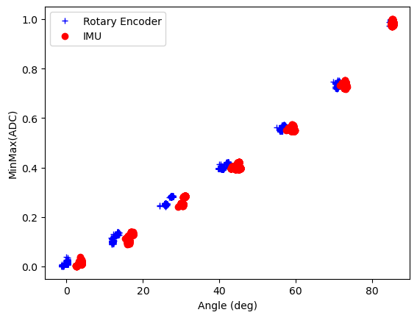
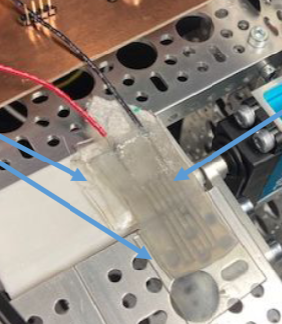
As a reminder….Sample ABS_100
40% elongation

Slide 5
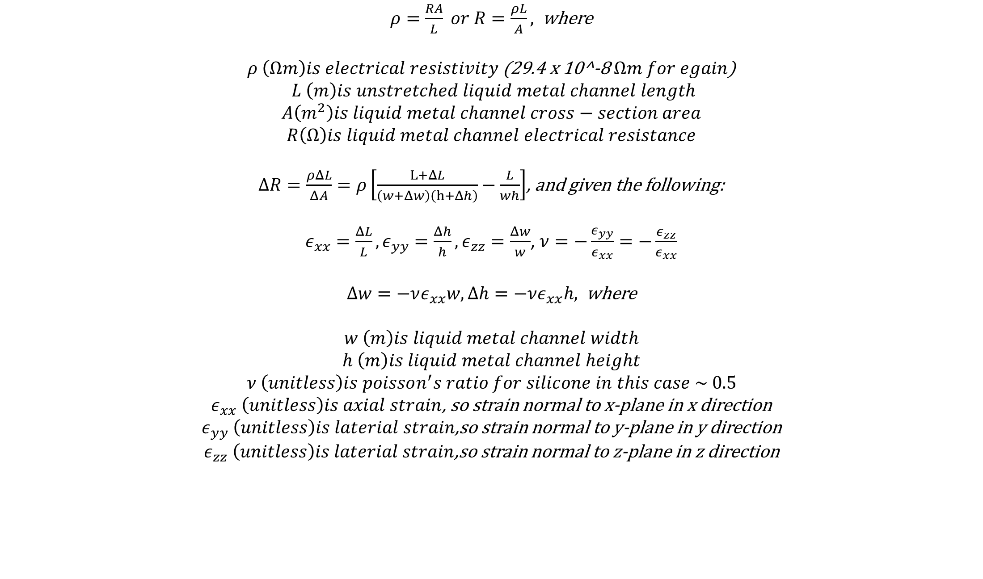
$ρ=\frac{RA}{L} or R=\frac{ρL}{A},$where
$ρ \left(Ωm\right)is electrical resistivity$ (29.4 x 10^-8 $Ωm for egain$)
$$L \left(m\right)is unstretched liquid metal channel length$$
$$A\left(m^{2}\right)is liquid metal channel cross−section area$$
$$R\left(Ω\right)is liquid metal channel electrical resistance$$
$ΔR=\frac{ρΔL}{ΔA}=ρ\left[\frac{L+ΔL}{\left(w+Δw\right)\left(h+Δh\right)}−\frac{L}{wh}\right]$, and given the following:
$ε_{xx}=\frac{ΔL}{L},ε_{yy}=\frac{Δh}{h}, ε_{zz}=\frac{Δw}{w}$, $ν=−\frac{ε_{yy}}{ε_{xx}}=−\frac{ε_{zz}}{ε_{xx}}$
$Δw=−νε_{xx}w, Δh=−νε_{xx}h,$where
$$w \left(m\right)is liquid metal channel width$$
$$h \left(m\right)is liquid metal channel height$$
$$ν \left(unitless\right)is poisson^{′}s ratio for silicone in this case \sim 0.5$$
$ε_{xx} \left(unitless\right)is axial strain$, so strain normal to x-plane in x direction
$ε_{yy} \left(unitless\right)is laterial strain$,so strain normal to y-plane in y direction
$ε_{zz} \left(unitless\right)is laterial strain$,so strain normal to z-plane in z direction

Slide 6
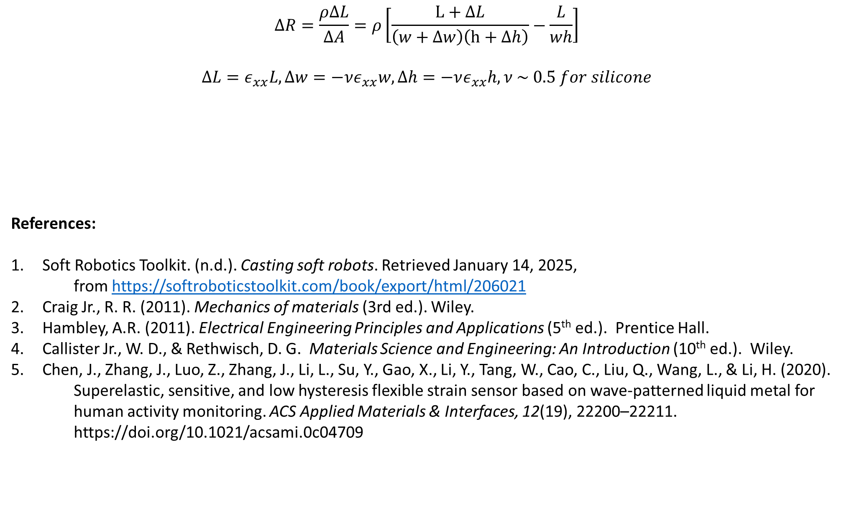
$$ΔR=\frac{ρΔL}{ΔA}=ρ\left[\frac{L+ΔL}{\left(w+Δw\right)\left(h+Δh\right)}−\frac{L}{wh}\right]$$
$$ΔL=ε_{xx}L, Δw=−νε_{xx}w, Δh=−νε_{xx}h, ν \sim 0.5 for silicone$$
References:
Soft Robotics Toolkit. (n.d.). Casting soft robots. Retrieved January 14, 2025,
from https://softroboticstoolkit.com/book/export/html/206021
Craig Jr., R. R. (2011). Mechanics of materials (3rd ed.). Wiley.
Hambley, A.R. (2011). Electrical Engineering Principles and Applications (5th ed.). Prentice Hall.
Callister Jr., W. D., & Rethwisch, D. G. Materials Science and Engineering: An Introduction (10th ed.). Wiley.
Chen, J., Zhang, J., Luo, Z., Zhang, J., Li, L., Su, Y., Gao, X., Li, Y., Tang, W., Cao, C., Liu, Q., Wang, L., & Li, H. (2020).
Superelastic, sensitive, and low hysteresis flexible strain sensor based on wave-patterned liquid metal for
human activity monitoring. ACS Applied Materials & Interfaces, 12(19), 22200–22211.
https://doi.org/10.1021/acsami.0c04709
$$ΔR=\frac{ρLε_{xx}}{wh}\left[\frac{8−ε_{xx}}{{\left(2−ε_{xx}\right)}^{2}}\right]→\frac{ΔR}{R_{o}}=\frac{ρLε_{xx}}{whR_{o}}\left[\frac{8−ε_{xx}}{{\left(2−ε_{xx}\right)}^{2}}\right]=normalized resistance where R_{o}is initial resistance$$

Slide 7
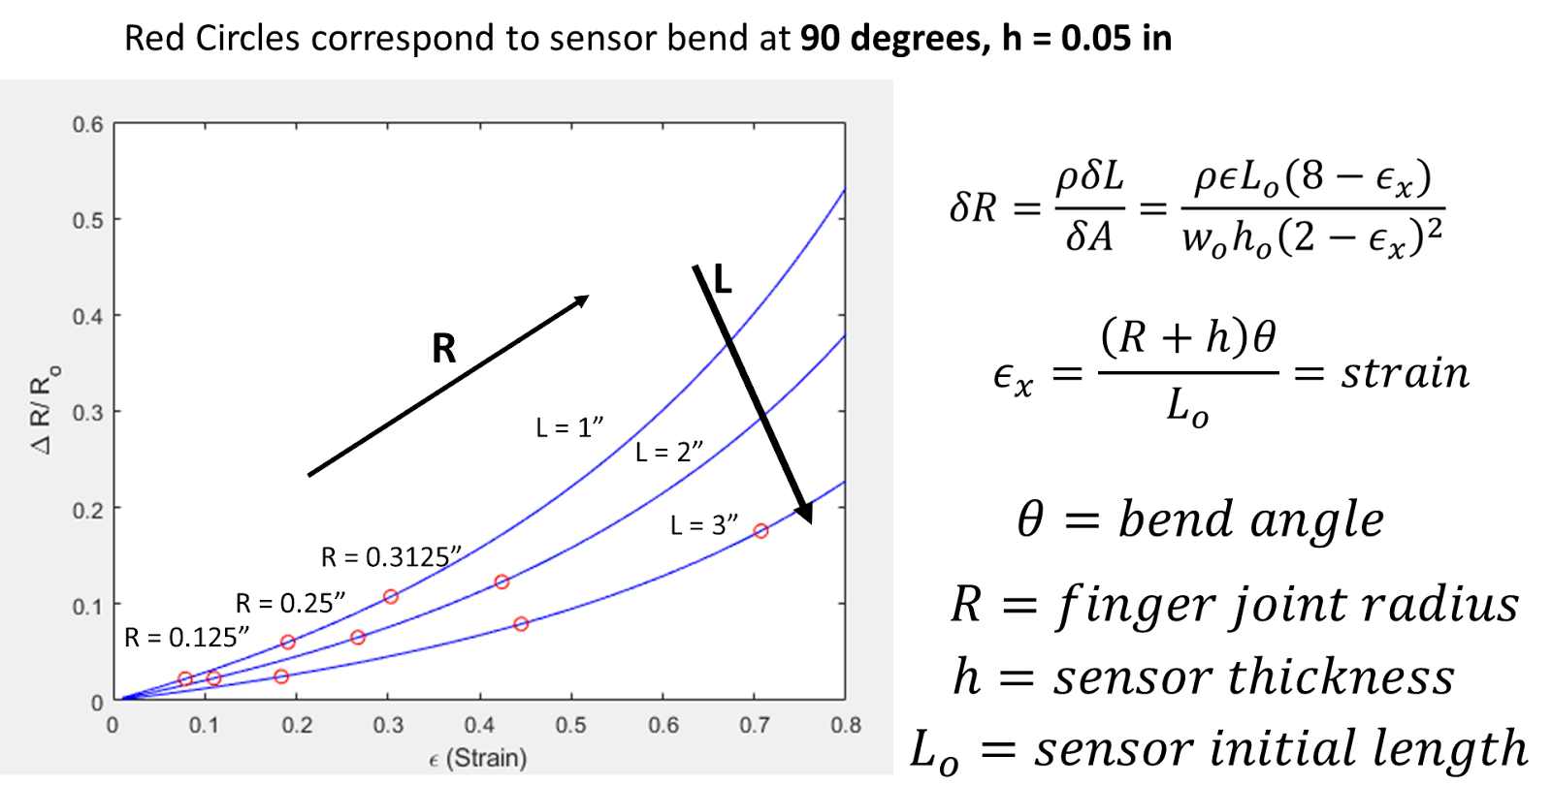
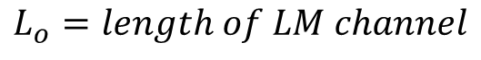
$$L_{o}=length of LM channel$$
Sample Length (not LM channel length)
Previous slide results strained to 40% elongation at L = 1.67”

Slide 8
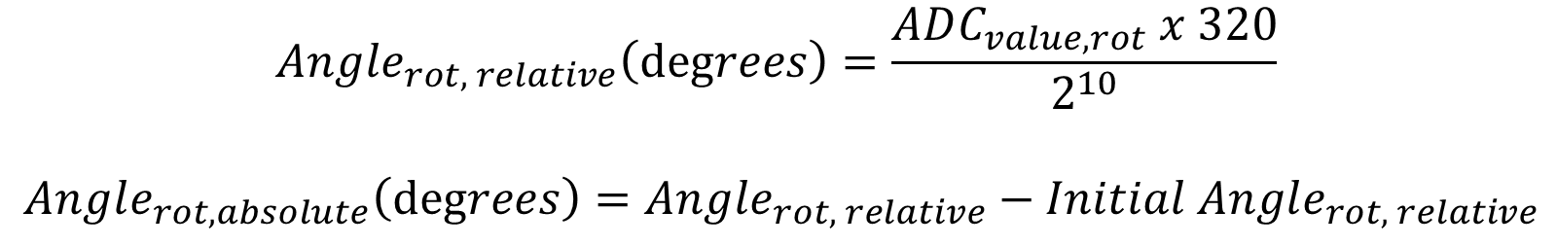
$$Angle_{rot, relative}\left(degrees\right)=\frac{ADC_{value, rot} x 320}{2^{10}}$$
$$Angle_{rot, absolute}\left(degrees\right)=Angle_{rot, relative}−Initial Angle_{rot, relative}$$

Slide 9
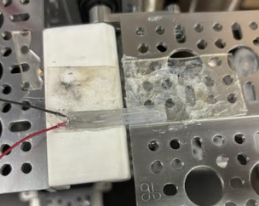
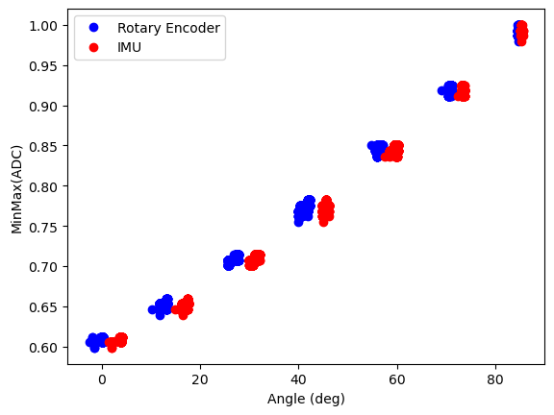
New Sample 11_21_2024
Wire Lead Gauge size CHANGED TO = 30 (from 28)
44.5% elongation
0.25” width
1.5” sample length
0.02” x 0.02” square cross-section channels

Slide 10
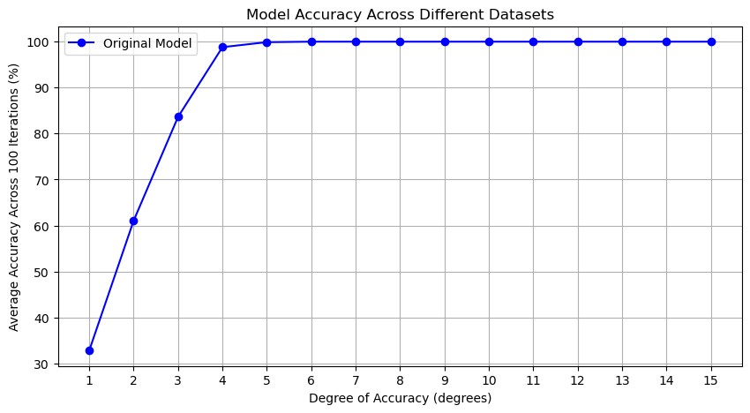

Slide 11
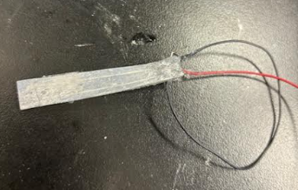
Sample 2.27” Long -> will test Monday

Slide 12
12_5_2024

Slide 13
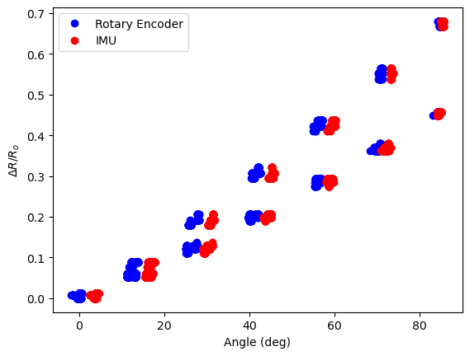
Comparing Sample Lengths
1.5 inches
2.31 inches

Slide 14
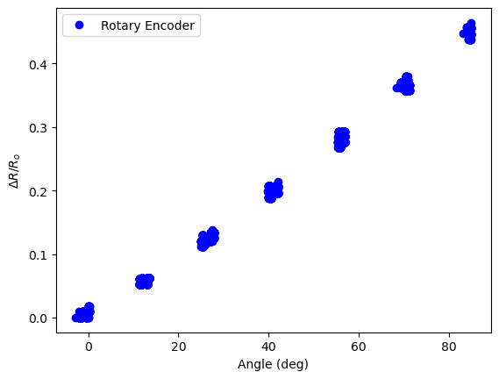
Across Two Samples: 2.3” and 2.31”

Slide 15
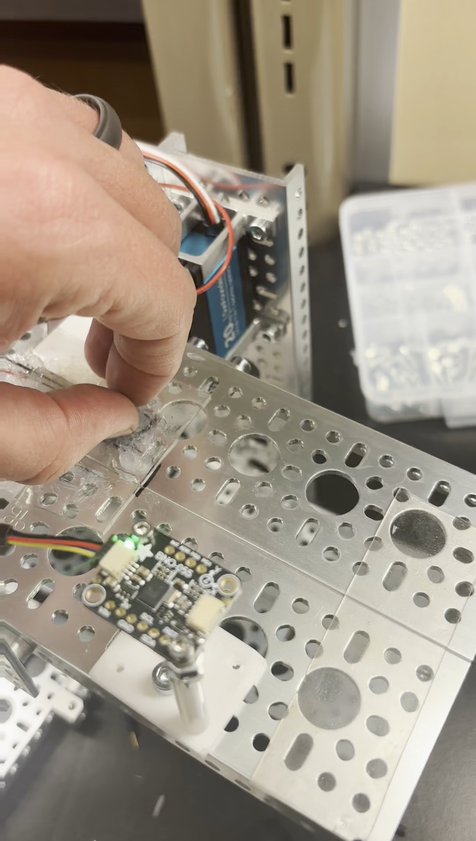
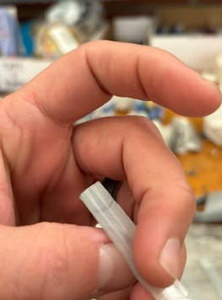
Initial Reapplication Issues
Problem Solved by Adding More Silicone to Inlet

Slide 16
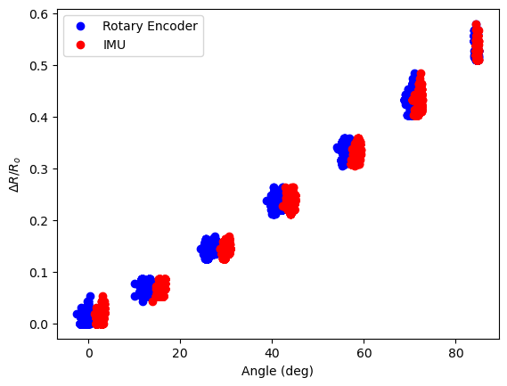
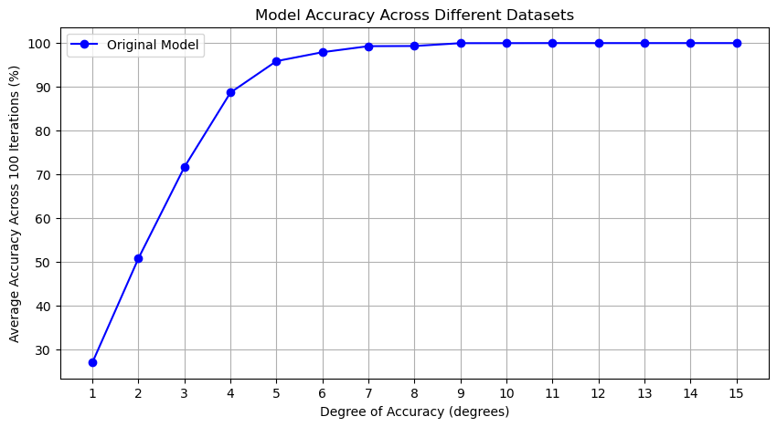
Reapplication 3x

Slide 17
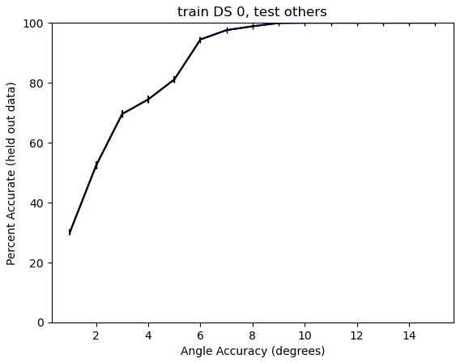
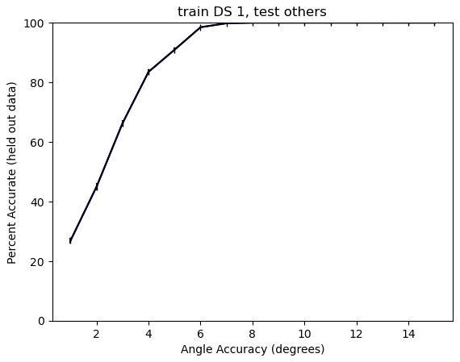
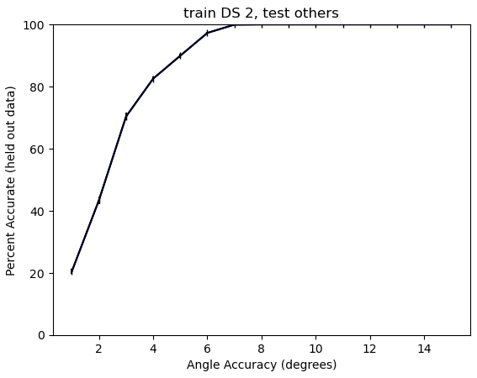
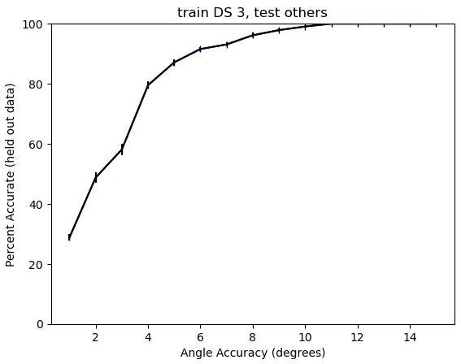

Slide 18
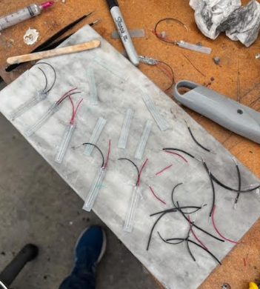
Angle Testing: Monday….

Slide 19
12/12/2024

Slide 20
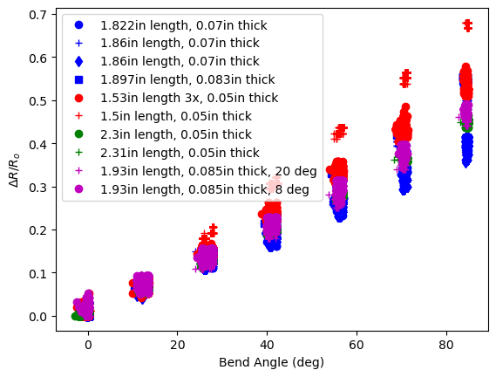

Slide 21
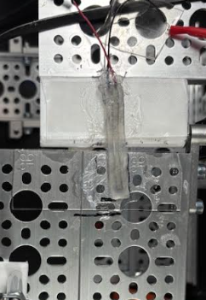
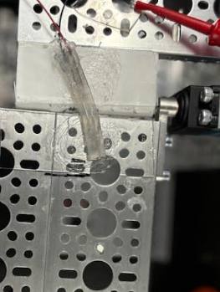
Angle Testing
8 Deg
20 Deg

Slide 22
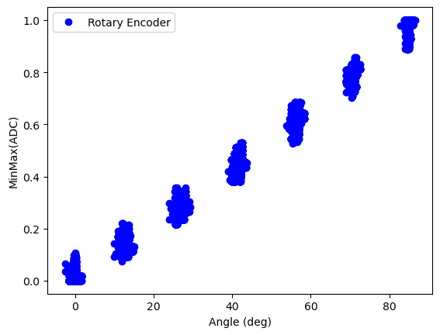
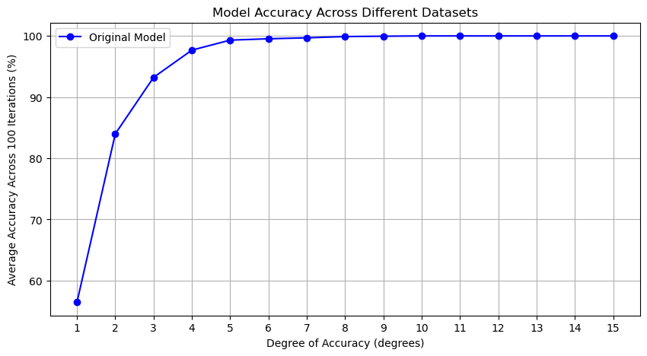

Slide 25
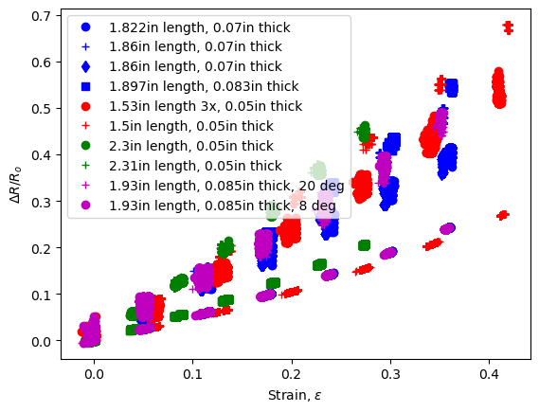
Model Data

Slide 26
12/19/2024

Slide 27
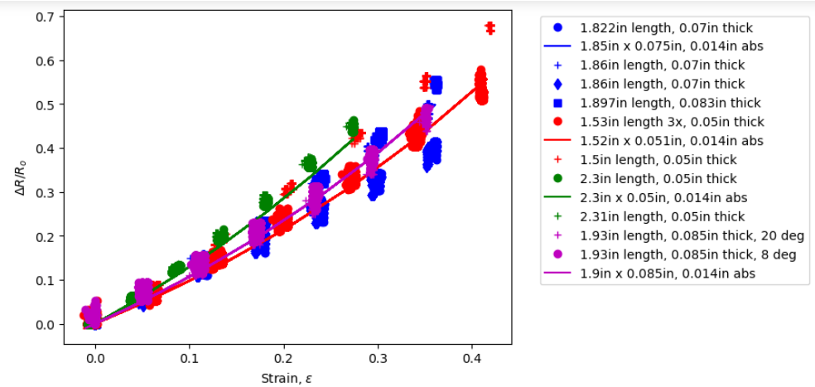
Model Curve Changes Drastically When ABS print size changes drastically by 0.001” (0.0254mm)
Changed cross section from 0.02” x 0.02” to 0.014” x 0.014”, so 0.006” height and width

Slide 28
Model Curve Changes Drastically When ABS print size changes drastically by 0.001” (0.0254mm)
Changed cross section from 0.02” x 0.02” to 0.014” x 0.014”, so 0.006” height and width
0.01” x 0.01”
0.02” x 0.02”

Slide 29
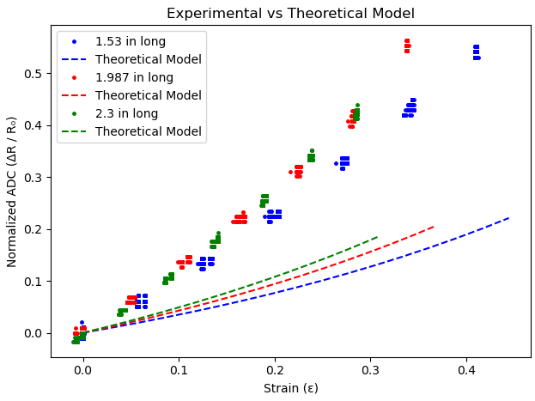

Slide 30
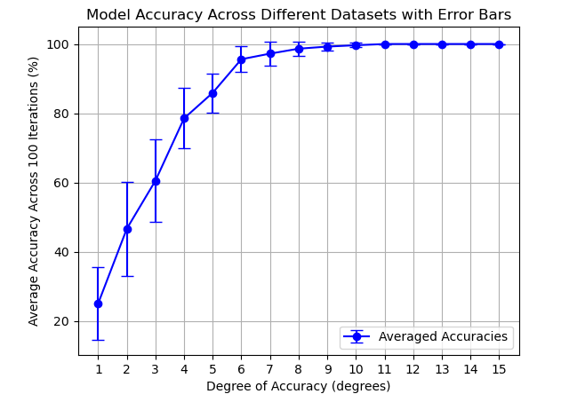
4x Reapplication Errorbars: Using MinMax -> 0 to 1 12 prediction files worth of data

Slide 31
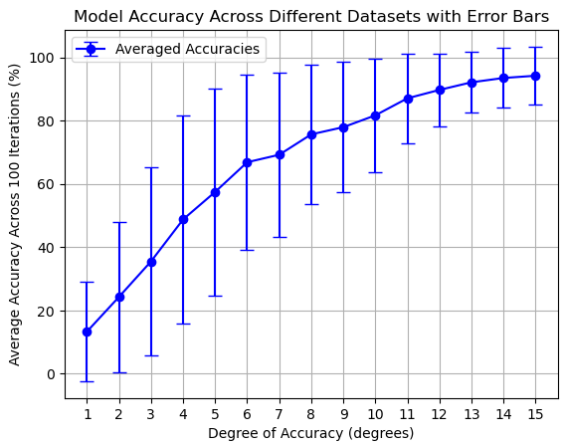
4x Reapplication Errorbars: Using Norm Res 12 prediction files worth of data

Slide 32
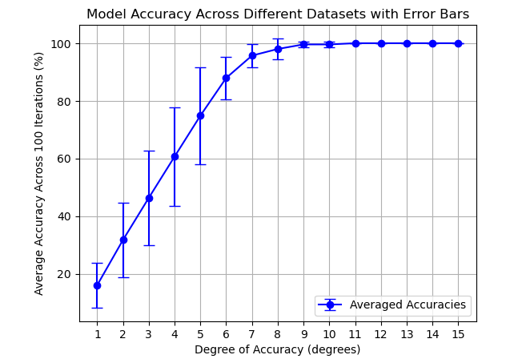
Misalignment and MinMax: 0, 8, 20 deg 6 prediction files worth of data

Slide 33
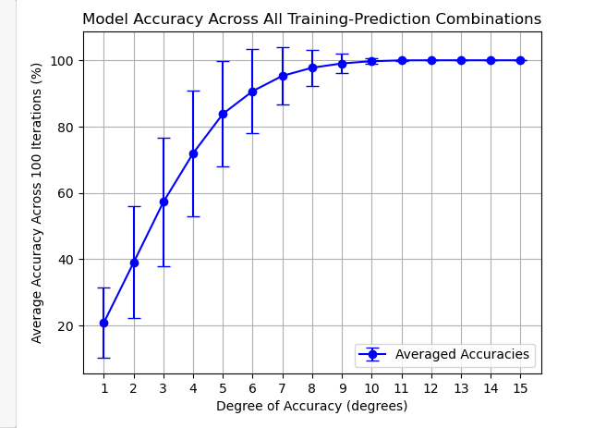
Across Sensor Repeatability: MinMax 12 files, where 1 is trained and is used to predict rest -> 132 prediction files in total

Slide 34
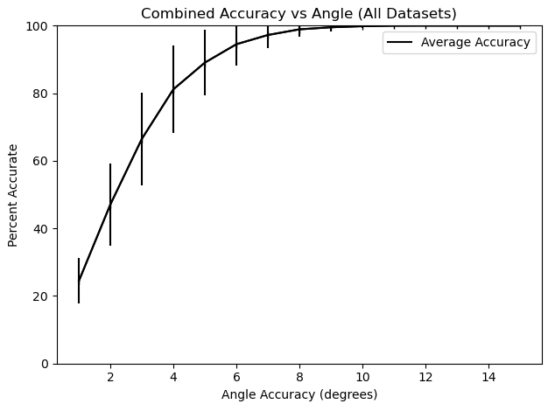

Slide 35
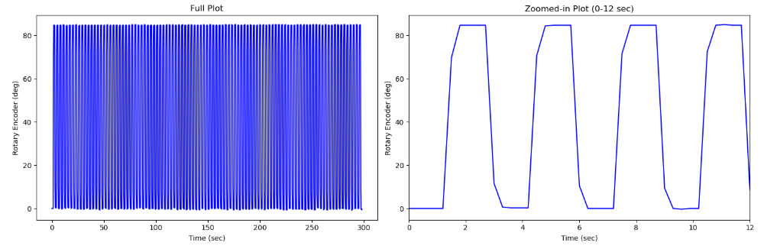
Rot Enc. Dynamic Test: 100 Cycles, Period is 300 ms, collect 5 data points every 300 ms, 333 deg/sec

Slide 36
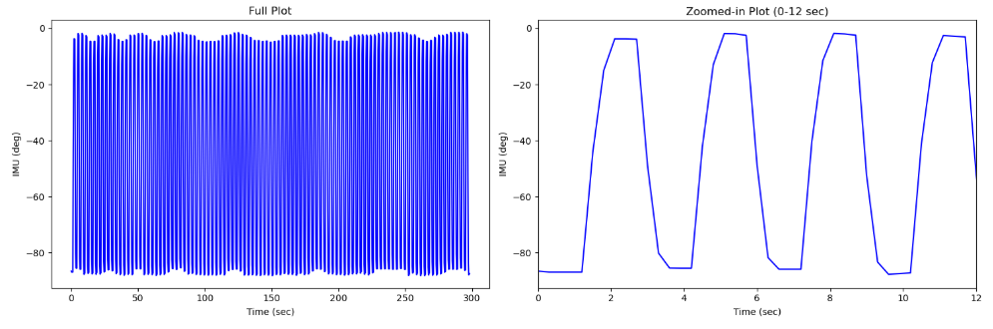
IMU Dynamic Test: 100 Cycles, Period is 300 ms, , collect 5 data points every 300 ms, 333 deg/sec

Slide 37
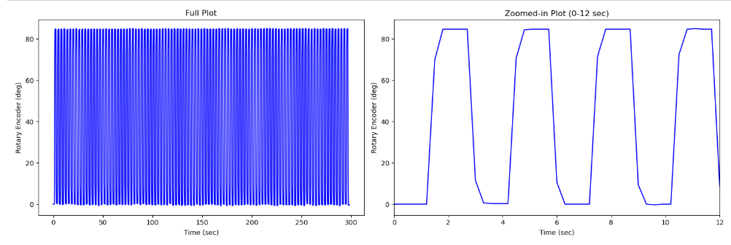
IMU Dynamic Test: 100 Cycles, Period is 1 sec, collect 15 data points every 1 sec, 333 deg/sec

Slide 38
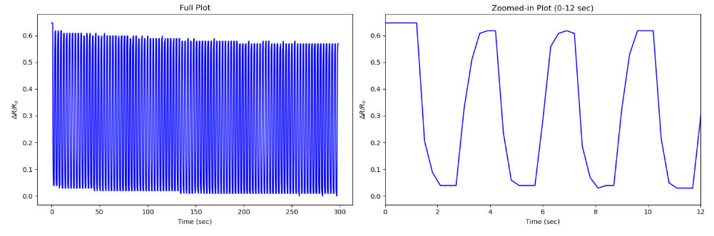
Strain Sensor Dynamic Test: 100 Cycles, Period is 300 ms, collect 5 data points every 300 ms, 333 deg/sec

Slide 39
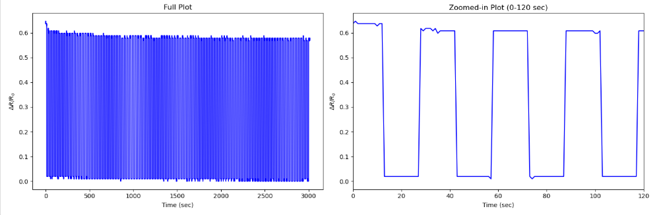
Strain Sensor Dynamic Test: 100 Cycles, Period is 1 sec, collect 15 data points every 1 sec, 333 deg/sec

Slide 40
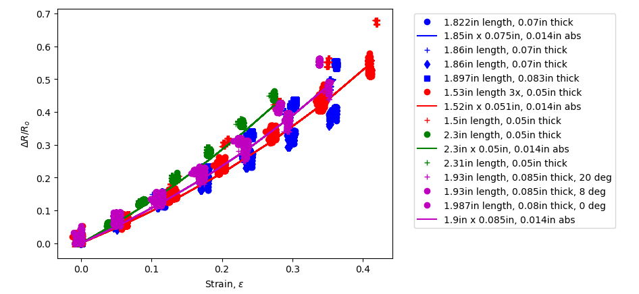
Comparing peak 0 deg norm res to 100 cycle

